Slide 1
Datalog Comparator User Manual

Slide 2
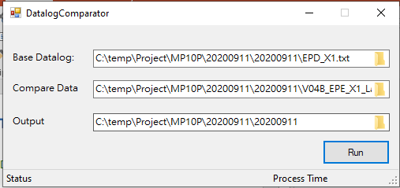
DatalogComparator
Purpose : Base on first release test program datalog to see any Tname change, limit update.
GUI
Input file
Output path
Base Datalog: First release datalog.
Compare Data: Next release version datalog.
Output: Diffreoprt output path.

Slide 3
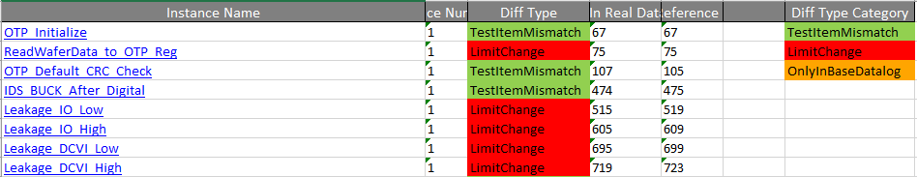
DatalogComparator
There are 3 diff type category here for you reference

Slide 4
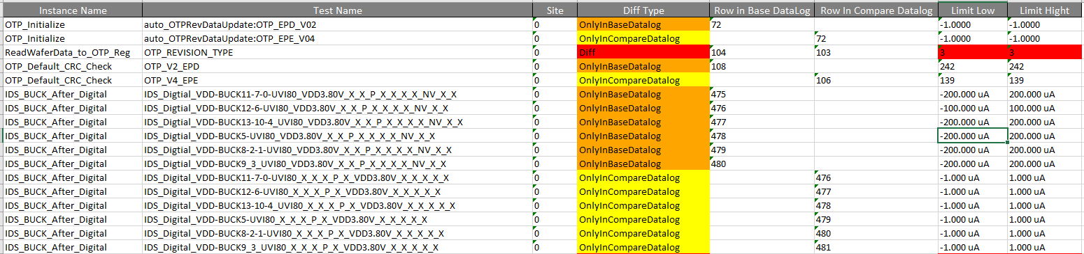
DatalogComparator
1. OTP version update V02 to V04
2. Limit update
3. Tname update from NV to VDD3.8

